Slide 1
European Revolutions
1815-1848

Slide 2
Revolutions Disrupt Europe
Congress of Vienna succeeded in preventing wars between states (interstate conflicts) for the next half century.
Many revolutions occurred inside states, (intrastate conflicts) however, between 1815 and 1848.
Liberals & nationalists openly revolted against Conservative governments.

Slide 3
Three forces struggle for supremacy in Europe
 | Conservatives | Liberals | Radicals
Made up of: | Wealthy property owners, nobility | Middle class business leaders ,merchants. teachers, and lawyers. | Lower classes of the cities. Urban poor.
What they wanted | To protect the monarchies | Give more power to elected parliaments Only let landowners and the educated vote | Extend democracy to the people – all the people
While these 3 fought a 4th grew:
Growing Nationalism blurred the lines between these political beliefs
Called for loyalty to the nation, not a single ruler
When a nation also has it’s on government it becomes a “nation-state”

Slide 4
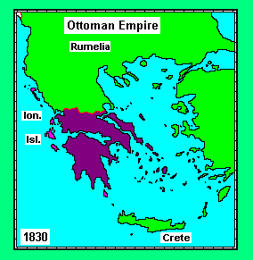
Revolution in the Balkans
Balkans controlled by
Ottoman Empire (Turks).
(present day Greece, Albania, Bulgaria & Turkey)
Greeks revolted against Ottomans in 1821.
Greeks gained support around the world & gained independence with help
from British, French Russians

Slide 6
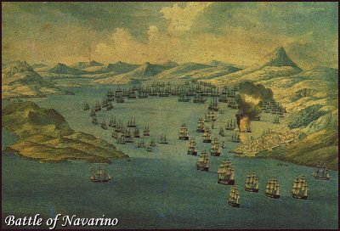
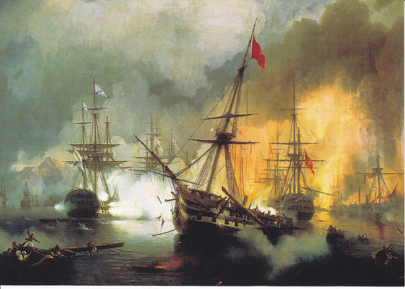
Battle of Navarino, 1827
Combined British,
French, and Russian
fleet destroyed the
Turkish-Egyptian
fleet.
Resulted in treaty
granting complete
independence to
Greece.

Slide 7
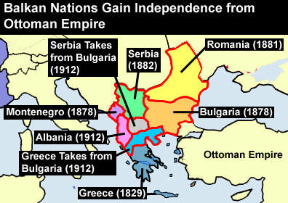

Slide 8
Revolutions of 1830
By 1830 the Old Regime reestablished at the Congress of Vienna in 1815 , was falling apart.
Nationalists rebelled against conservative control in several liberal countries
Liberals wanted a self-ruled, republican government and an establishment of nation- states
British poet, Lord Byron wears the uniform of a Greek Freedom fighter

Slide 9
Revolutions, Winners & Losers
Belgians win independence from Dutch
Italian nationalists were defeated by Austria
Klemens von Metternich
Poles revolted against Russian rule but were defeated within a year
Late 1830
Increased Polish nationalism because Poles from Austrian & Prussian Poland joined the revolt against Russia.

Slide 10
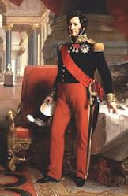
Reforms & Revolutions in France, again
1830 - King Charles X, of France attempted a return of Absolute Monarchy
riots forced him to flee to Great Britain
Louis-Phillippe replaced him
Supported liberal reforms
Ruled France until 1848
Forced to abdicate in favor of a republic
Exiled to Britain
Louis-Phillippe
The “Citizen-King”

Slide 11
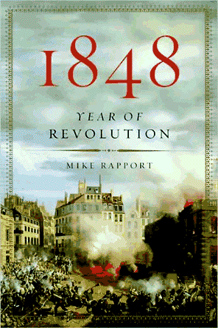
Revolutions of 1848
Ethnic uprisings in the
Austrian Empire:
By Hungarians
By Czechs
And in Austria itself, Metternich forced to resign after angry mobs clashed with police in Vienna.

Slide 12
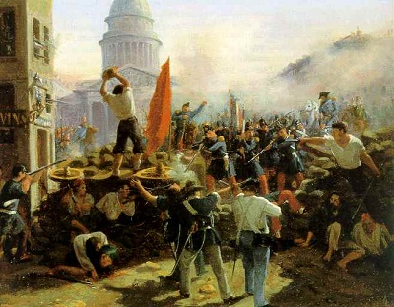
History Repeats Itself ! Revolution in France, 1848
Monarchy (Louis-Philippe) overthrown
Second French Republic
was established.
New, moderate constitution results in elected president.
Louis-Napoleon
Then what happens?

Slide 13
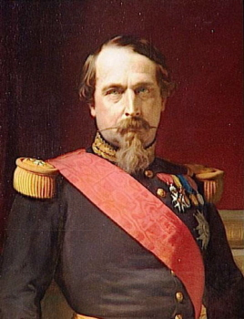
History Repeats Itself ! Louis-Napoleon Bonaparte (Napoleon III)
1848: Elected president and established republican govt.
1851: Took over government in coup d’etat.
1852: Assumed title of emperor.
Reasserted French influence in Europe and abroad. Aggressive foreign policy.
1870: Deposed after losing (and being captured in) the Franco-Prussian War.
Exiled to England where he died in 1873.
Louis-Napoleon Bonaparte
Nephew of Napoleon

Slide 14
Europe in 1848
Which large
empires still
exist?
Which future
countries
have not yet
unified?
Predict the
impact of
nationalism
on all these
territories.

Slide 15
European Nationalism
1848-1871

Slide 16
Rising Nationalism Force for Unity or Disunity?
Unity
Disunity
Led to creation of new unified nation-states.
United and inspired large masses of people.
Caused some long-established empires to split and crumble.
Used by leaders to whip up support for war and foreign conquest.

Slide 17
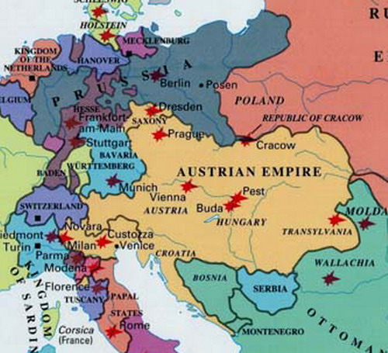
Nationalism Shakes Aging Empires
Three aging empires:
1) Austrian (Hapsburg)
2) Ottoman
3) Russian
All three included many
different ethnic groups
Ethnic unrest weakened
all three empires.

Slide 18
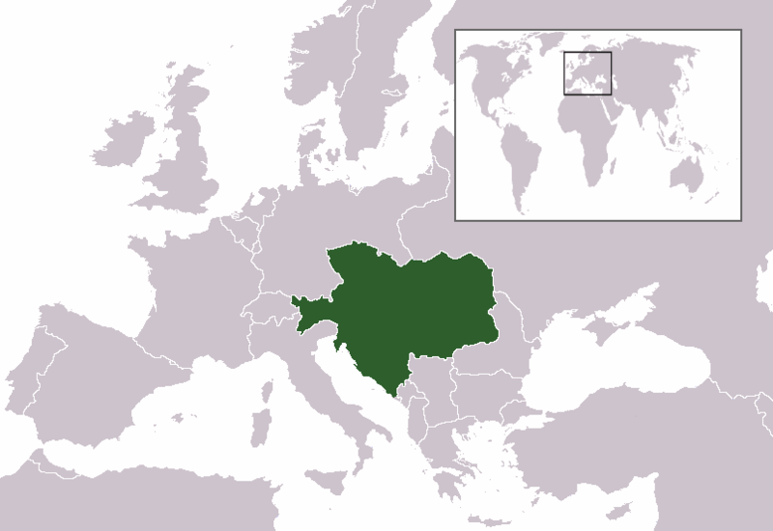
Breakup of Austrian (Hapsburg)Empire
Empire included Hungarians,
Germans, Czechs, Slovaks,
Croats, Poles, Serbs, Slavs,
Italians.
Weakened by the competing
demands of all these different
ethnic groups
.

Slide 19
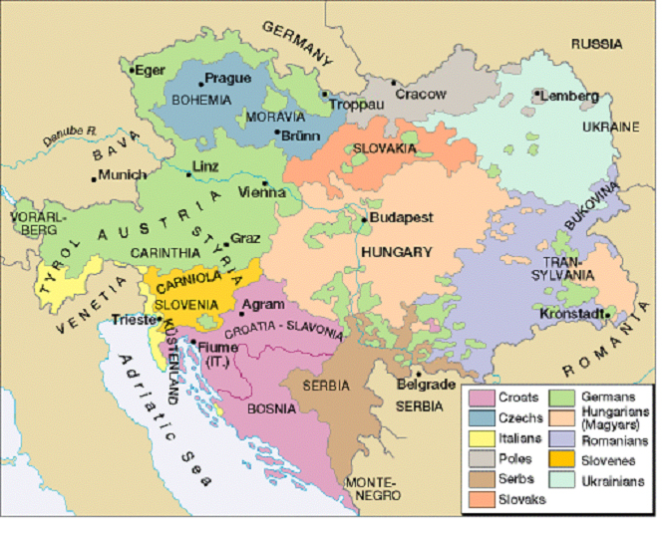

Slide 20
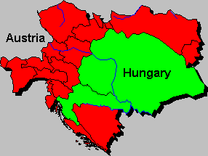
Division of Austrian (Hapsburg) Empire
In compromise with non-
German Hungarians,
Emperor Franz Joseph
split Austrian empire in
half in 1866.
“Duel Monarchy” formed
with Austria and Hungary
becoming separate and
equal states.

Slide 21
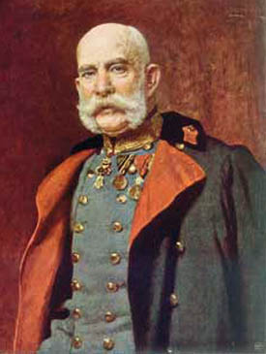
“Duel Monarchy” of Austria-Hungary
Separate constitutions and
separate parliaments.
Same Hapsburg ruler would
be emperor of Austria and
king of Hungary.
Common ministry for finance,
foreign affairs, and war.
Franz Joseph

Slide 22
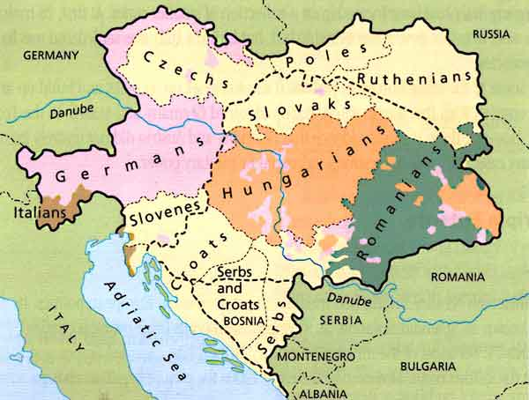
Austria-Hungary
Austria-Hungary
was
Permanently dismantled after World War I

Slide 23
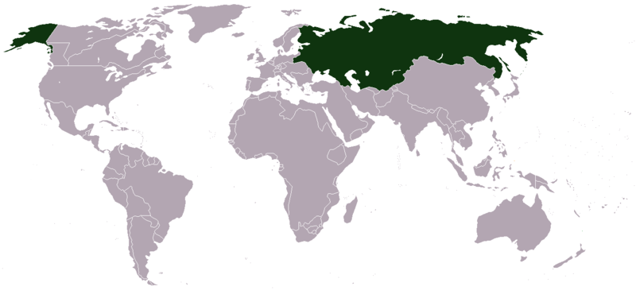
The Russian Empire Crumbles
Comprised of Russians,
Ukrainians, Lithuanians, Estonians,
Finns, Jews, Romanians,
Georgians, Latvians,
Armenians, and Turks.
Each had its own culture.
Russification– forcing Russian culture all ethnic groups
– strengthened nationalist feelings.
Rising nationalism caused disunity and weakened the empire, which could not survive World War I or the communist revolution 1917.

Slide 24
Decline of the Ottoman Empire

Slide 25
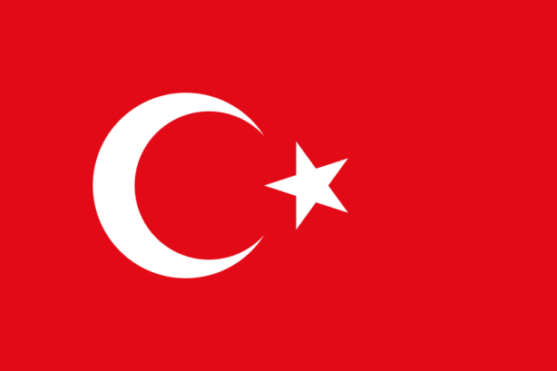
The Ottoman Empire Weakens
The Ottomans (Turks) controlled
Greeks, Slavs, Arabs, Bulgarians,
and Armenians.
Granted equal citizenship to all people
under its rule.
This angered conservative Turks
Massacred & deported Armenians,
in response to nationalism
Disunity follows… empire broke
apart after World War I
.

Slide 26
The Unification of Italy
1858-1870

Slide 27
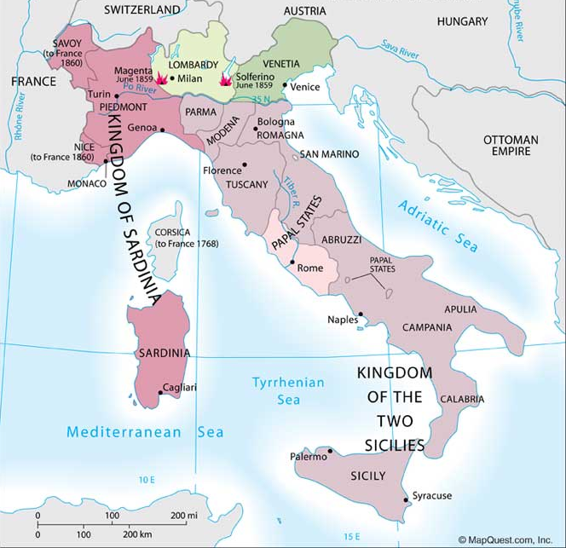
Italian Unification
Italian city-states unify and become Kingdom of Italy in 1871.
Italy formed from the
territory of crumbling
empires.
Political instability and economic problems kept Italy a poor country.

Slide 28
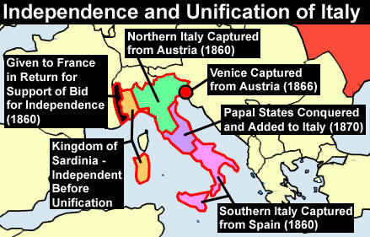

Slide 29
The Unification of Germany
1865-1871

Slide 30
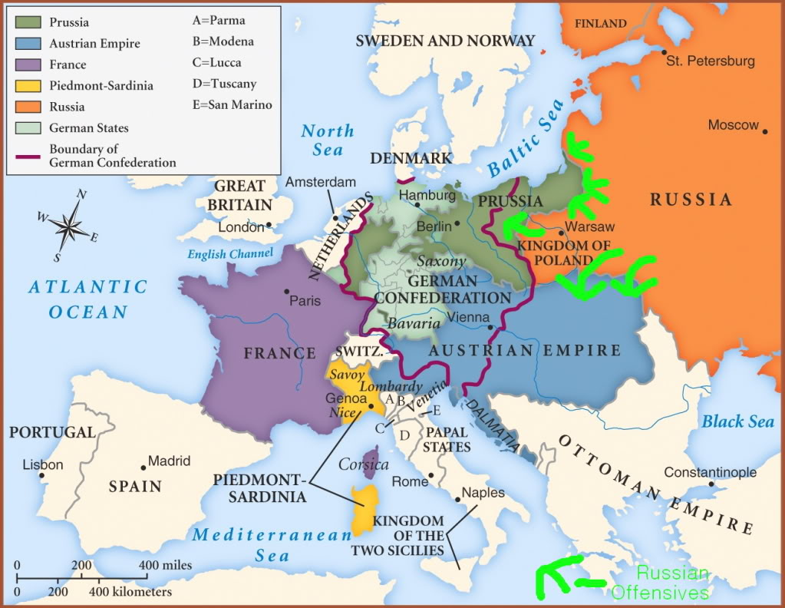
German Confederation, 1815

Slide 31
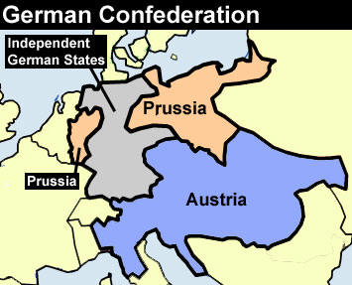
The German Confederation Great Power Rivalry
Prussia and Austria were the dominant
members of German Confederation.
Power struggle between
Prussia and Austria for control of
German states.

Slide 32
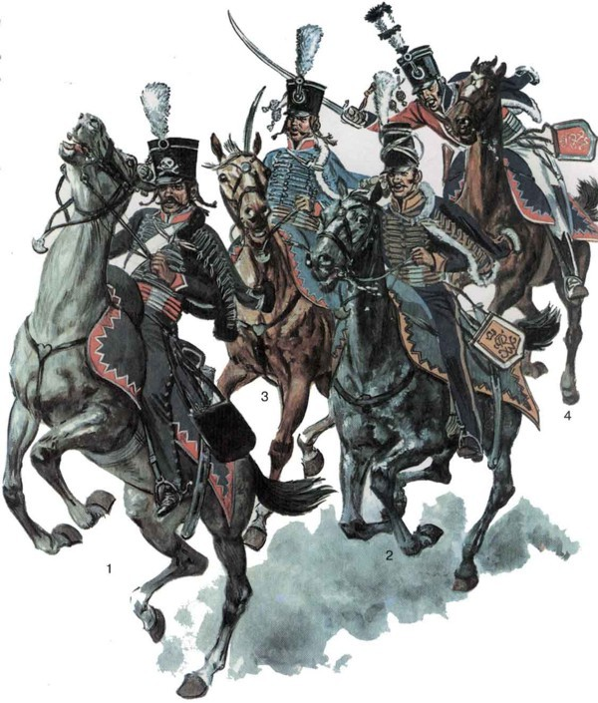
Prussia’s Strengths
Mainly German population
---- not divided by different
ethnic groups
Result: Nationalism unified
Prussia.
Most powerful army
central Europe.
Army controlled by Junkers
---- conservative and wealthy
landowners who supported
a strong monarchy.

Slide 33
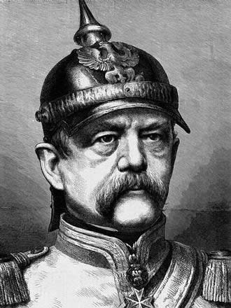
Otto von Bismarck
When liberal Parliament
challenged his authority,
King Wilhelm I appointed
Otto von Bismarck
( a Junker) as Prussia’s
Prime Minister in 1862.
Bismarck remembered for
his foreign policy driven
by realpolitik.”
Otto von Bismarck

Slide 34
Realpolitik (Realism)
Tough “power politics.”
Focuses on relations
between great powers
.
Stresses importance of
nation’s interests over
it’s ideals.
Means doing whatever
is necessary to achieve
one’s goals, not what is
moral or right
.

Slide 35
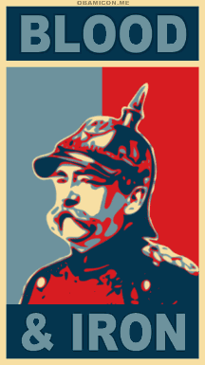
“Blood and Iron”
Bismarck declared he would rule
without consent of parliament.
First speech:
“The great questions of the day
will not be settled by speeches or
majority decisions -- but by
blood and iron”
Earns the nickname, the “Iron
Chancellor.”

Slide 36
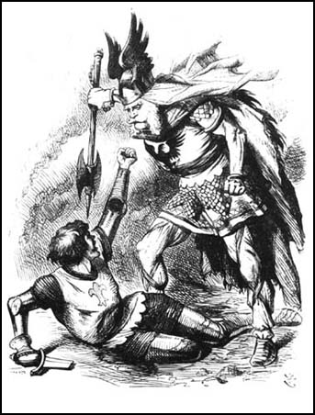
Bismarck Expands Prussia Through War
Bismarck went to war with
what countries to expand
Prussia’s influence and its
control over German
territories?
Denmark in 1864
Austria in 1866
France in 1867

Slide 37
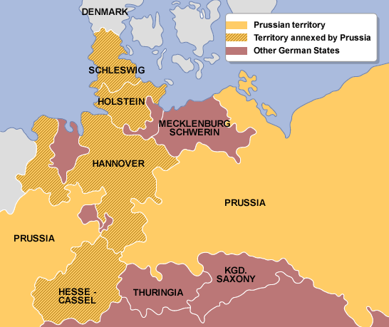
1864 Prussia Attacks and Defeats Denmark,
In 1863, the King of Denmark declared Schleswig and Holstein to be a part of Denmark.
In 1864, Prussia and Austria teamed up and declared war on Denmark. They won easily.

Slide 38
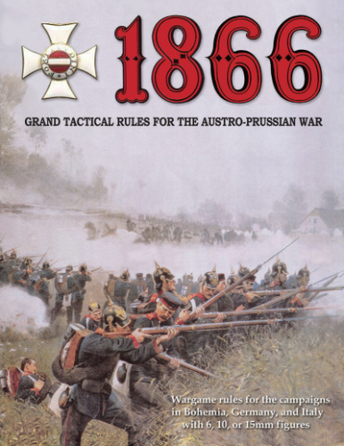
Austro-Prussian (or Seven Weeks) War 1866
Resulted from rivalry between
Austria and Prussia to be
the dominant German state.
Each had German allies.
Brief war won by Prussia
and its ally, Italy.
Marks shift in power among
German states away from
Austria and towards Prussia.

Slide 39
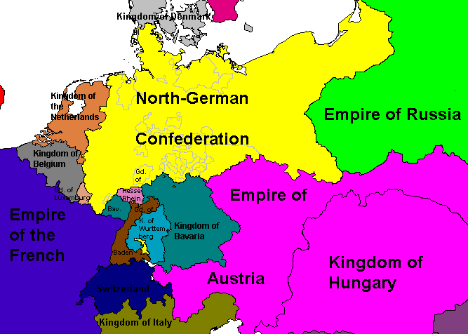
Austro-Prussian War
Ended German
confederation.
New Northern German Confederation
Established which excluded
southern German
states and Austria.
Isolated Austria.

Slide 40
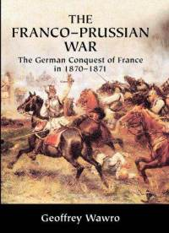
Franco-Prussian War, 1867-1871
Southern German states were
________ and resisted control
by _________Prussia.
1867: Bismarck incited _____to
declare war on Prussia in order
to unite southern German states
behind him.
Outcome of Franco-Prussian War?
Prussia defeated France and all
German states accepted Prussia’s
leadership.
Catholic
Protestant
France

Slide 41
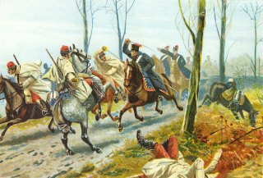

Slide 42
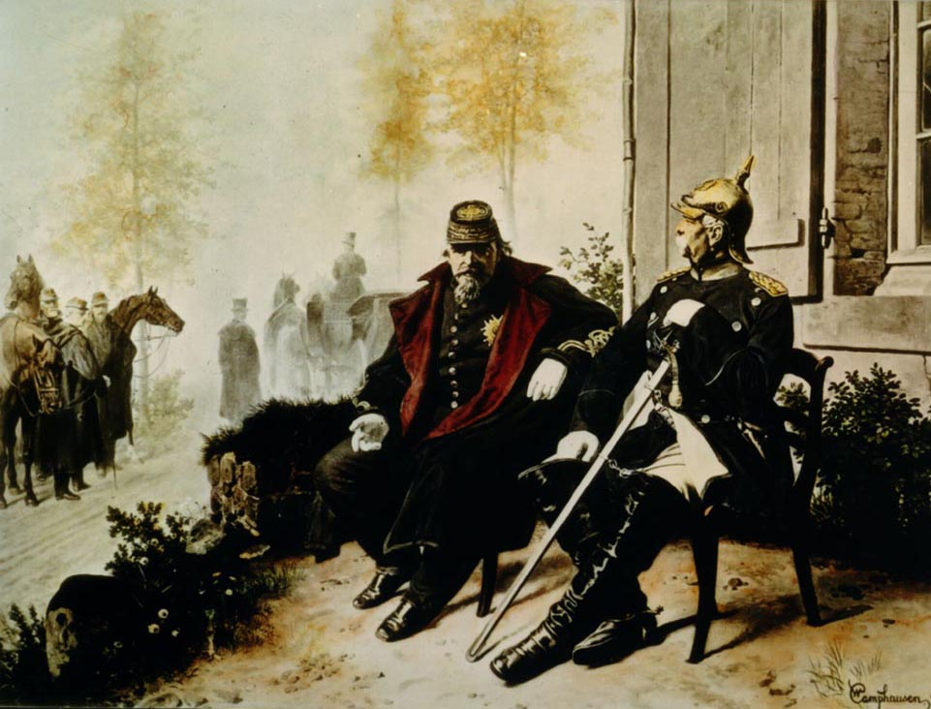
Napoleon III of France, captured by the Prussian army
during the Franco-Prussian War, with Bismarck.

Slide 43
The New German Empire
After Prussian victory over
France, King Wilhelm I
crowned kaiser (emperor).
New German empire called
the “Second Reich”
Bismarck had won Prussian
dominance over Germany
and Europe just as he had
promised to do – through
“blood and iron”
.

Slide 44
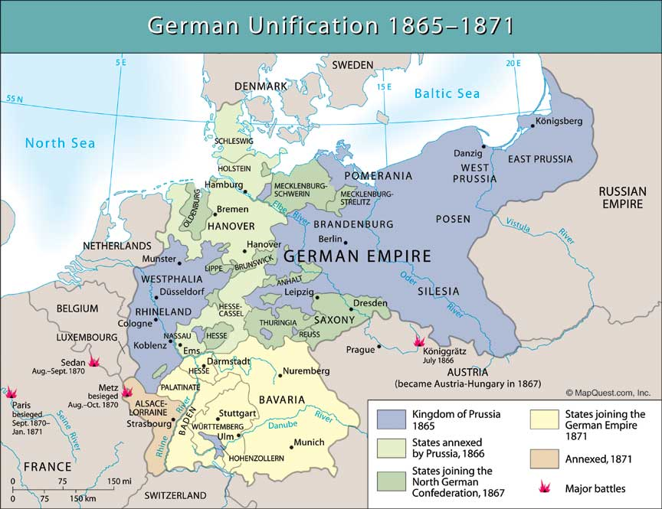
Annexed after Seven Weeks War of 1866.
States that agreed to formation of a Second German Empire after the Franco-Prussian War of 1870-1871.

Slide 45
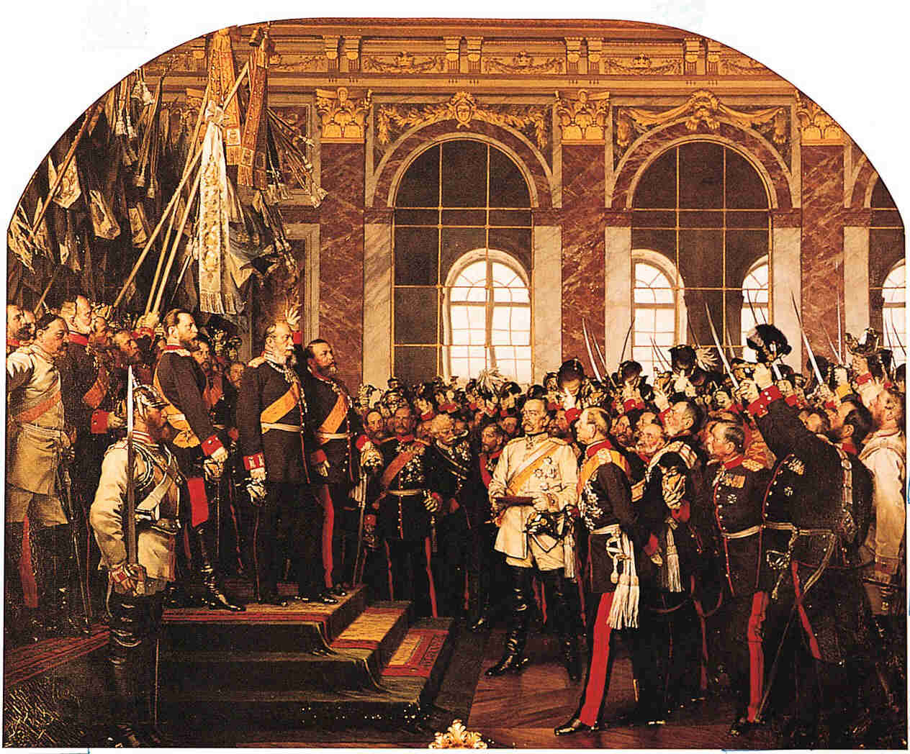
Proclamation of the German Empire (1871)

Slide 46
Europe’s Balance of Power Shifts
Great powers of europe
1871
Great Powers of Europe
1815*
*Five state with relatively
equal power
Great Britain*
France
Russia
Austria - Hungary
Germany*
Italy
* Most powerful
Great Britain
France
Russia
Austrian Empire
Prussia

Slide 47
